Slide 1
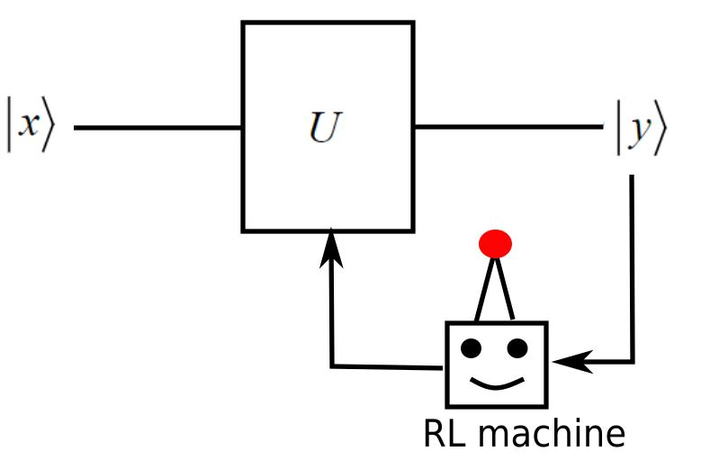
Reinforcement Learning for Designing Quantum Circuits
Group 4 - Quantum Learning; Reinforced Tolerance
A play in 3 acts
Dramatis Personae
Owen Huisman, Renze Suters, Charles Renshaw-Whitman
And Starring: the RL machine

Slide 2
Act I: RL Theory
CHARLES Enter Stage Right
Act I: RL Theory
Act II: Methodology and Setup
Act III: Problems and Results

Slide 3
30 Second Overview
Reinforcement Learning can be used to solve problems involving decision-making and planning, often in very complex environments
We apply reinforcement learning techniques to design quantum circuits under a variety of conditions
Planning = “If I place gate X now, I may move much further away from the target, but I can then place gate Y and get even closer than I am now!”
Act I: RL Theory

Slide 4
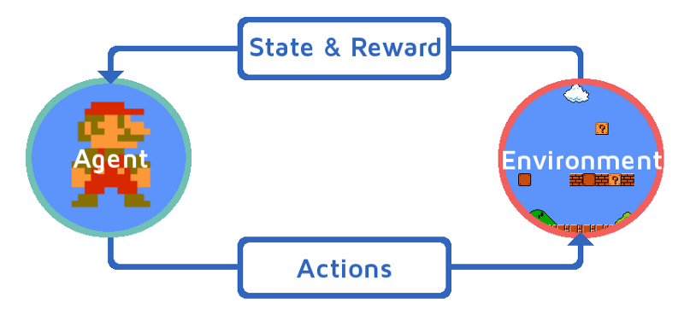
1-minute introduction to Reinforcement Learning (RL)
An agent observes the state of the environment → Based on these observations, it takes an action in an attempt to maximise the received reward.
Image credit:
https://www.educba.com/what-is-reinforcement-learning/
Act I: RL Theory

Slide 5
1-minute introduction to Reinforcement Learning (RL)
The agent is two main parts:
- Some function π_{θ}(A, S) which quantifies “How good do I think it is to do A given that I observe state S?”
- An algorithm for changing the function’s parameters θ in an attempt to maximise ‘reward’
Note! θ is a whole ‘vector of parameters’ → The way that π depends on θ can be very complex - often, θ will be all the weights in a neural network!!
Image credit:
https://www.educba.com/what-is-reinforcement-learning/
Act I: RL Theory

Slide 6
1-minute introduction to Reinforcement Learning (RL)
N.B. ‘Learning’ means setting these θ based on observations/rewards → the specifics of this are _really_ complicated, but can think of it as a ‘gradient-ascent’ problem
→Associated with many ‘hyperparameters’
Image credit:
https://www.educba.com/what-is-reinforcement-learning/
Act I: RL Theory

Slide 7
Act II: Methodology and Setup
CHARLES Exit Stage Left
RENZE Enter Stage Right
Act I: RL Theory
Act II: Methodology and Setup
Act III: Problems and Results
Notes:
Let’s talk about the way we use Reinforcement Learning to design quantum circuits.
Designing quantum circuits using a native gate set can be highly non-trivial. This is true especially for complicated algorithms using a large number of qubits or under noisy conditions. Therefore, our goal is to use a Reinforcement Learning agent or learner to implement a desired unitary using a given gate set, for example H, T and CNOT gates.

Slide 8
The Big Idea: Get agent to implement a desired Unitary U_{desired} on the basis of observations of output |y>
I know that the circuit here takes |x> to |y>, so I can figure out U_{implemented}. What gate should I place to make U_{implemented} closer to U_{desired}?
For a state |x>, run the circuit, and observe the output |y>
Act II: Methodology and Setup
Notes:
This is the situation: we have a quantum circuit, where the agent applies a unitary U to some input state x. The agent has access to the output y, and makes changes to the unitary U, in order to achieve a certain target output state that matches the outcome of the desired unitary operation.
Training the agent or learner consists of running multiple so-called episodes. An episode starts with an empty circuit; U is just the identity. Then, per episode, the learner has multiple opportunities or timesteps to place gates at the end of the current circuit. It can place one gate per timestep, so one gate after the other. The agent can also choose to do nothing to the currently implemented unitary and end the episode.
At the end of the episode, the learner receives its reward based on the output it has managed to produce.
After ending one episode, a new one is started, and this process is repeated for hundreds or thousands of episodes in order to let the learner explore the state space of its available actions and corresponding rewards.

Slide 9

Setup
An agent observes the state of the environment → Based on these observations, it takes an action in an attempt to maximise the received reward.
For us:
Environment = Quantum Circuit
State = output of quantum circuit for each of a few different inputs
Actions = Gates the agent is allowed to place
Reward = Any measure of the distance between U_{desired} and U_{implemented} → average over input states a_{i} of Fidelity( U_{desired}|a_{i}>, U_{implemented} |a_{i}> )
Act II: Methodology and Setup
Notes:
Let's be more precise with the Reinforcement Learning terminology in our context.
Charles has already explained that an agent or learner observes the state […] received reward.
For us, the learner's environment is a quantum circuit. We used Qiskit to run classical simulations of quantum circuits. The environment, the quantum circuit, consists of the input state x, unitary operation U and output y as we've already seen.
The state observation is basically the output of the circuit y for a few different input states x.
Based on how closely the output state y matches the desired output, the learner is rewarded to perform a certain action, which is placing a sequence of gates that make up the unitary U.
The reward, then, is a measure of how close the actual implementation is to the desired output. We used a function of the fidelity of the output state compared to the desired output as the learner's reward and we take the average of this fidelity for all different inputs.
We used Tensorforce to implement the Reinforcement Learning scheme. Tensorforce is basically a high-level wrapper for the well-known TensorFlow machine learning library. The learner converts its observation into a specific action and in doing so, it trains an underlying neural network, based on the reward it receives.

Slide 10
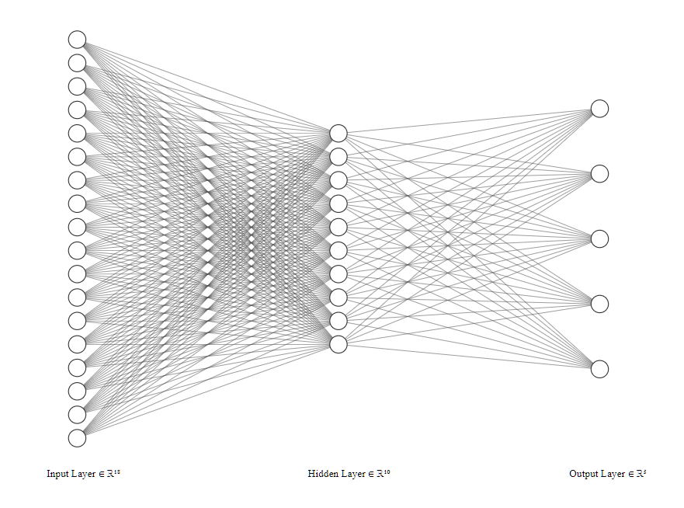
Our neural network
“Do Nothing and end episode”
Input Density matrices Re(ρ^{(+x)}_{ij}), Im(ρ^{(+x)}_{ij}), Re(ρ^{(-x)}_{ij})...
“Append H gate”
“Append X gate”
“Append T gate”
“Append Z gate”
Image generated using
http://alexlenail.me/NN-SVG/index.html
Act II: Methodology and Setup
Notes:
This is a schematic of our neural network, the underlying structure that converts the learner's observation into an action.
The neural net that the learner is training consists of an input layer, an output layer and a layer in between. All layers have nodes, which are shown here as white dots.
The nodes of the input layer match the state observation, and the nodes of the output layer match the actions the learner can take.
In our implementation, the input layer consists of the density matrix entries rho ij of the output states for various input states x.
All nodes in the network need to be real, which is why one density matrix entry rho ij is split up into two nodes: one is the real part of that entry and the other one is the imaginary part.
The output nodes correspond to actions, which, in our case, is placing gates at the end of the current circuit. In this way, each node corresponds to a specific gate in the set of gates available to the learner, the H gate for instance.
We use one so-called hidden layer in between the input and output nodes. The hidden layer has a number of nodes that is in between the number of input and output nodes.
Now, the nodes of the different layers are interconnected by so-called weights, shown here as the lines connecting the white dots. An input state is entered into the input layer nodes and based on the weights in between it is connected to the nodes of the hidden layer. The nodes of the hidden layer are subsequently connected by weights to the output layer. Based on which output node is activated the most for a given input state, the learner places one particular gate at the end of the circuit, or it does nothing to the circuit and terminates the episode upon which it receives a reward.
When training over a large number of episodes, the learner is supposed to tune the weights in between the nodes such that it performs actions that let it achieve higher rewards in the end.

Slide 11
Act III: Problems and Results
RENZE Exit Stage Right
OWEN Enter Stage Left
Act I: RL Theory
Act II: Methodology and Setup
Act III: Problems and Results

Slide 12
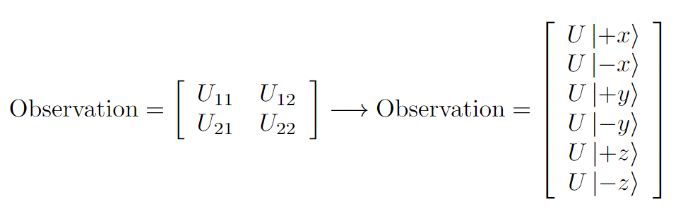
Problem 1: Unitary "Tomography"
Which observations characterise current circuit?
Instead of circuit, agent sees qubit states
All six cardinal states needed!
Act III: Problems and Results

Slide 13
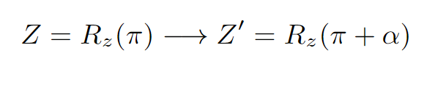
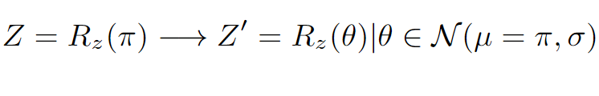
Problem 2: Avoiding Miscalibration
Can the agent deal with miscalibrated gates?
E.g.
Problem 3: Messy Gate Circumvention
How about gates a correct on average, but with Gaussian error
E.g.
Act III: Problems and Results

Slide 14

Problem 4: Efficient Clifford Gate Implementation
Can the the AI construct the Clifford group from its generators H,T.
Problem 5: Gate Approximation
Solovay-Kitaev: gate can be approximated up to error <ε, using # gates =
How efficient is the AI?
Act III: Problems and Results

Slide 15


Results
With Z a faulty gate, AI learns avoids Z and uses less faulty gates to complete the circuit.
Act III: Problems and Results

Slide 16
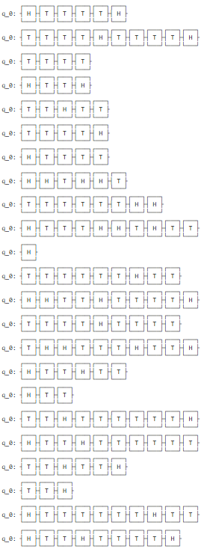
Results
The AI was able to find all Clifford gates - up to a global phase.
Act III: Problems and Results

Slide 17
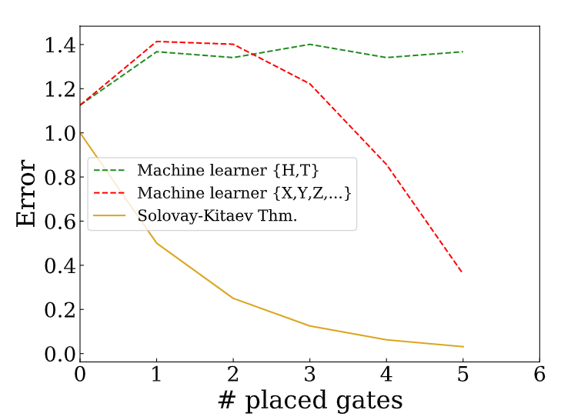
Results
Act III: Problems and Results

Slide 18
Discussion
Current caveats
Need to run learner multiple times to converge properly
Only limited ability to approximate gates
Not yet easily expandable to more than 1 qubit
Future possibilities
Tune hyperparameters
Run ‘real-time’ noise correction
Act III: Problems and Results

Slide 19
Summary
Outline
The RL agent learns to construct a desired unitary U using observations on the output state
Results
Avoid faulty and noisy gates
Constructed all 24 Clifford gates from H and T
Approximate gates
Limited by learner ability (hyperparameters)
Act III: Problems and Results

Slide 20

Image Credit: https://www.shutterstock.com/video/clip-1001452-stock-footage-opening-and-closing-red-curtain-with-spotlights.html

